Slide 1
CKI Structure
CKI
CKI
Circle K International
Circle K International
CKI 101 – Part 2

Slide 2
Membership Orientation
CKI Organizational Structure
The Tenants of CKI
The District Level
The International Level
Recruiting within CKI
Running an Event
Membership Opportunities

Slide 3
Pop Quiz!
Question: Recite the CKI Pledge!
Answer: I pledge to uphold the objects of Circle K International, to foster compassion and goodwill towards others through service and leadership, to develop my ability and the ability of all peoples, and to dedicate myself towards the realization of mankind’s potential.

Slide 4
CKI 101 Review
Circle K is the largest collegiate community service organization in the world, with over 15,000 students internationally, all dedicated to spreading our love of service, leadership and fellowship!

Slide 5
The CKI “Structure”
Circle K is broken down into multiple organizational levels, because there are hundreds of CKI clubs throughout the world.
All of Circle K International is connected by the similarly organized structure that can be found through each level of CKI.
CKI’s organizational structure is based off of Kiwanis’ structure (although it is not exact)

Slide 6
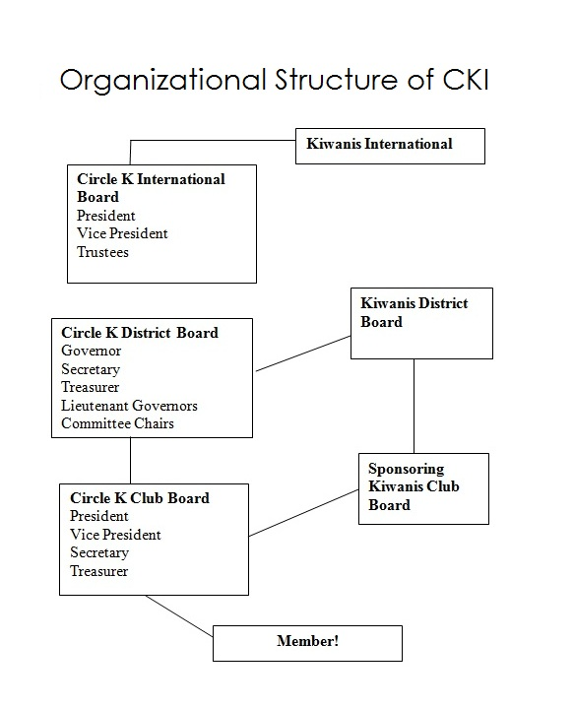

Slide 7
The Member
The most important part of CKI
Any person who pays their dues is a member
Does the service
Every “leader” in CKI is also a member

Slide 8
The Club
Board of Officers: The leaders of the club and the ones who organize most/all of the events.
Executive Board: President, VP, Secretary, Treasurer (typically elected)
Appointed Board: Committee Chairs (typically appointed by executive board)
General Membership: All the members within that club.

Slide 9
The Division
NOT ALL DISTRICTS HAVE DIVISIONS.
A division encompasses several clubs in a local area.
Can be between 2 to 8 clubs
Led by a Lieutenant Governor
Organizes division events and division council meetings
Communicates with division leaders in other Kiwanis Family Branches
Represents the club on higher levels

Slide 10
The District
A district encompasses several divisions
The District Board: The leaders of the District.
Committee Chairs: Appointed officers who specialize in certain aspects of CKI
Lieutenant Governors or Club Representatives: Represent their clubs on the district level.
Executive Officers: A District Governor, District Secretary, District Treasurer (positions may vary from district to district)

Slide 11
The Subregion
A subregion encompasses several districts in an local area.
Usually between 3-6 districts
Led by an International Trustee
Communicates between district officers
Represents the districts on higher levels

Slide 12
Are all Districts Subregioned?
Nope!
Certain Districts (ex: DACA) and even clubs are not part of a Subregion.
Typically international districts and clubs.

Slide 13
Subregion versus Region
A region determines the amount of money a CKI club has to pay for their yearly dues/fees:
Region 1: $600
Region 2: $450
Region 3: $300
Based on the GDP wealth of that country (to which the club belongs to)

Slide 14
International
The International level encompasses all the clubs within CKI, including non-subregioned districts and non-districted clubs.
The International Board: The International President, the International Vice President (who represented non-subregioned clubs), and the seven International Trustees.

Slide 15
Where do you fit in?
No matter what office someone holds, or where they are in the “CKI Structure,” every person in CKI is a member, and is always part of a club.
This makes the club the core of the organization and the member the most important part of CKI.
Subsequent “levels” (District & International) are there to support the members of CKI.

Slide 16
Remember
Being in CKI is as much or as little as you want it to be!
Take advantage of all CKI has to offer ☺

